Slide 1
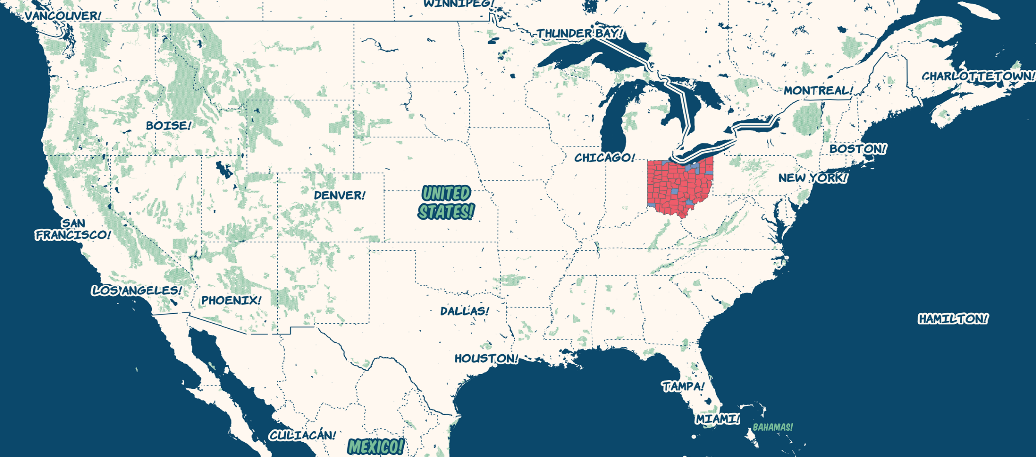
US Presidential Election Ohio 2016

Slide 2
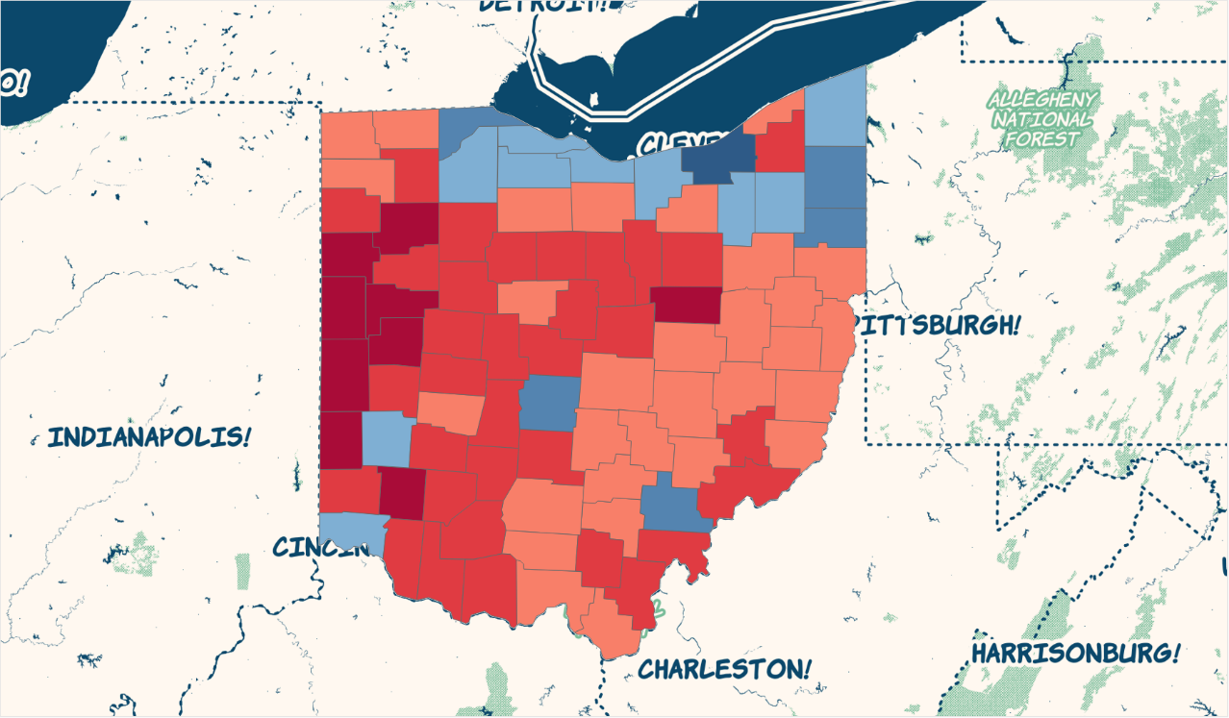
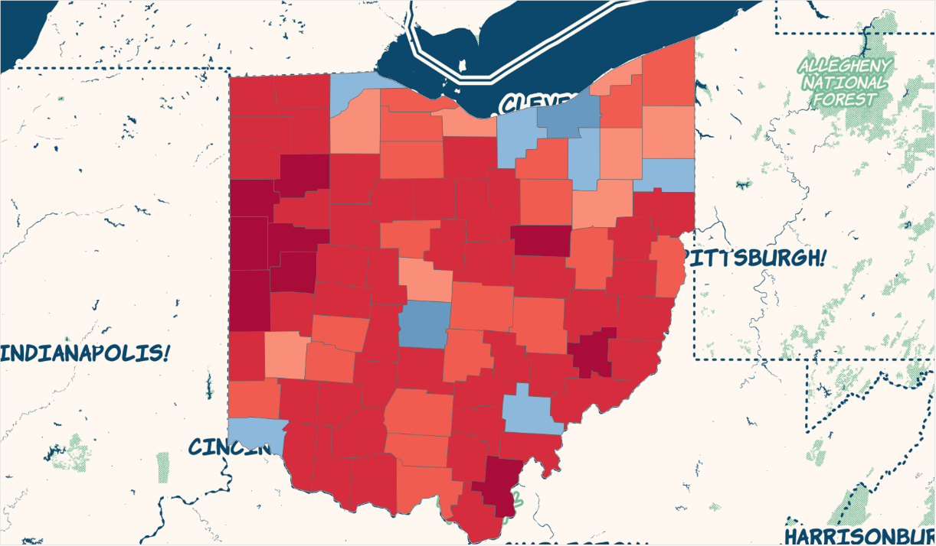
Ohio Electoral Map 2012 vs 2016
2016
2012

Slide 3
Ohio Electoral Map – Swing Counties

Slide 4
Ohio Electoral Map – Dem Density

Slide 5
Ohio Electoral Map – GOP Density

Slide 6
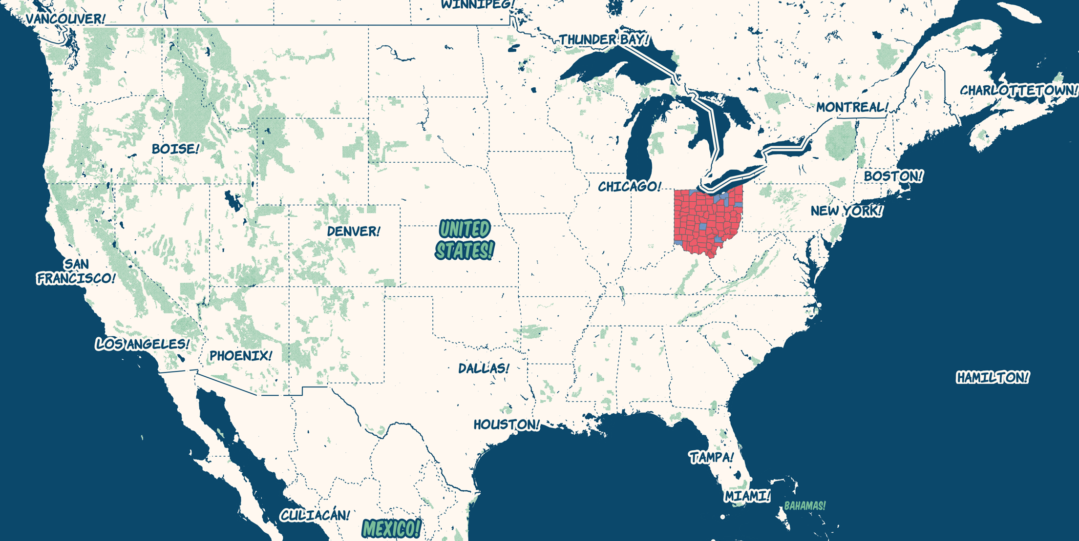
Ohio Electoral Map – Correlation

Slide 7
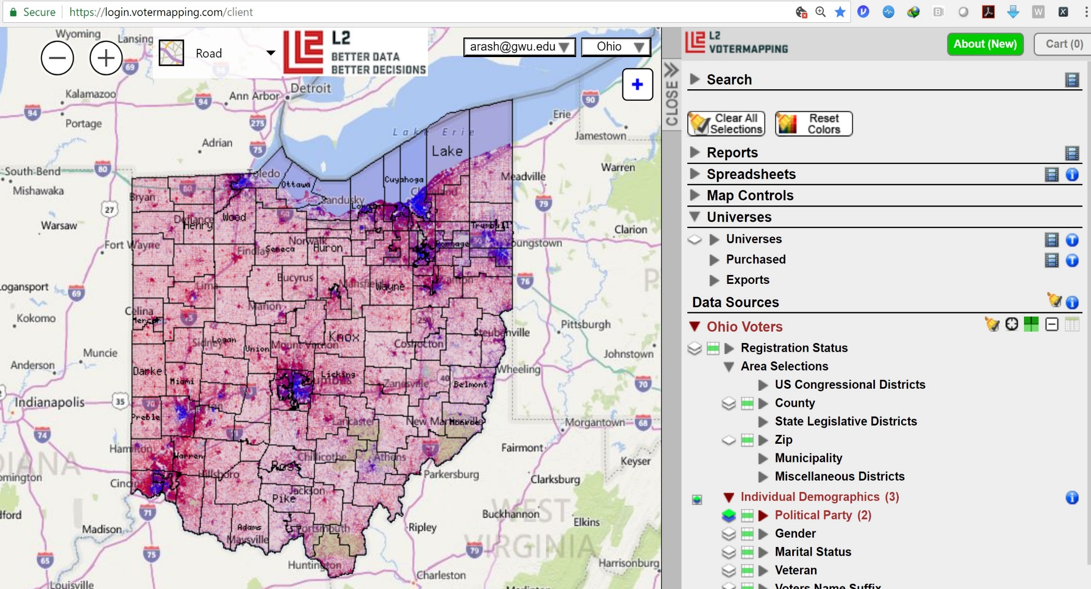
Ohio Electoral Map – L2 Voter File

Slide 8
2012 vs 2016: Ethnicity_Voted

Slide 9
2012 vs 2016: Ethnicity_P(Vote)

Slide 10
2012 vs 2016: Party-Affiliation_Voted

Slide 11
2012 vs 2016: Party-Affiliation_P(Vote)

Slide 12
2012 vs 2016: Education_Voted

Slide 13
2012 vs 2016: Education_P(Vote)

Slide 14
THANK YOU
Group Name
http://github.com/arashghafouri
add others

